Slide 1
What’s New in Acronis Cyber Cloud 8.0

Slide 2
Ensure your customers stay #CyberFit
Deliver cyber protection…
S
A
P
A
S
Safety
Accessibility
Privacy
Authenticity
Security
…in an easy, efficient, and secure way
Notes:
In order to stay competitive and grow, service providers need to ensure customers stay #CyberFit. That’s why, in order to ensure cloud partner success, each new version of Acronis Cyber Cloud improves both:
Partner cyber protection capabilities – enhancing some or all of the Five Vectors of Cyber Protection (safety, accessibility, privacy, authenticity, and security)
Partner delivery of cyber protection to end customers – making how they manage data protection day-to-day easier, more efficient and even more secure

Slide 3
Acronis Cyber Cloud 8.0: Highlights
Major improvements in base cyber protection components – safety and accessibility
New Advanced-edition features in Acronis Backup Cloud
New features in Acronis Disaster Recovery Cloud
New applications support: SAP HANA and Oracle Database
Easy
Efficient
Secure
Edition-based feature management and licensing for easier upsell
VPN-less deployment option for disaster recovery
Redesigned “Disaster Recovery” section in the web console
Group management of devices
Centralized backup plan management
10+ other improvements for streamlined management
Two-factor authentication to login to the web console
Encrypted backups support for disaster recovery
Automatic backup file notarization

Slide 4
Take a big step forward with Acronis Cyber Cloud 8.0
Access higher-end customers with new Advanced-edition features now available in Acronis Backup Cloud
Upsell Advanced and Disaster Recovery features with ease – via the familiar three-tiered pricing structure
Improve service delivery significantly via efficient group management operations in Acronis Backup Cloud
Sell Acronis Disaster Recovery Cloud with greater ease – with the highly-anticipated enhancements, plus simplified licensing and onboarding
Enhance total platform security with two-factor authentication for the web console login

Slide 5
Presentation contents
New edition-based feature management
New Licensing for Acronis Backup Cloud and Acronis Disaster Recovery Cloud
New features and enhancements in:
Acronis Cyber Cloud management portal
Acronis Backup Cloud
Acronis Disaster Recovery Cloud
Acronis Notary Cloud

Slide 6
New Edition-Based Feature Management

Slide 7
Acronis Cyber Cloud licensing structure in 7.9
New Acronis Cyber Cloud licensing structure in 8.0
Acronis Backup Cloud
Acronis Backup Cloud
Acronis Disaster Recovery Cloud
Standard edition
Advanced edition
Add-on to Acronis Backup Cloud
Disaster Recovery edition
Acronis Disaster Recovery Cloud is built in
Acronis Files Cloud
Acronis Files Cloud
Acronis Notary Cloud
Acronis Notary Cloud

Slide 8
About editions
Beginning with version 8.0, Acronis Backup Cloud is available in three editions:
Standard edition. Includes all features in Acronis Backup Cloud 7.9 and multiple new features added in 8.0.
Advanced edition. Includes all features in the Standard edition, plus a number of “advanced” features. These additional features include those related to scalable management of larger infrastructures and support for additional workloads.
Disaster Recovery edition. Includes all features in the Advanced edition, plus all features of Acronis Disaster Recovery Cloud.

Slide 9
Edition feature comparison
Features | Standard edition | Advanced edition | Disaster Recovery edition
All Acronis Backup Cloud 7.9 features
New “Standard” features in Acronis Backup Cloud 8.0
New “Advanced” features in Acronis Backup Cloud 8.0 Group management of devices Centralized backup plans management Application-aware SAP HANA backup and recovery Application-aware Oracle Database backup and recovery Cluster-aware backup of Microsoft SQL Server Cluster-aware backup of Microsoft Exchange Server Script-based backup location selection
All features available in Acronis Disaster Recovery Cloud, including the latest DR features enabled in 8.0

Slide 10
Editions management
Editions are per-customer-tenant, each customer tenant has one of the editions
A customer tenant can have only one edition, so each customer device is licensed by Standard, Advanced or Disaster Recovery editions
You can change the tenant edition (upgrade and downgrade are available) in the management console

Slide 11
Transition to editions
Acronis Cyber Cloud 7.9
Acronis Cyber Cloud 8.0
Acronis Backup Cloud
Standard edition
Acronis Disaster Recovery Cloud
Standard & DR Add-on (legacy)*
Advanced edition
Disaster Recovery edition
Automatic transition when Acronis enables 8.0
Transition initiated by partner (via the portal or API)
* See the next slide for end of life details regarding Standard and DR editions

Slide 12
EOL Transition Timeline for Standard & DR edition
Acronis Cyber Cloud 8.0
Acronis Cyber Cloud 9.0
Acronis Cyber Cloud 10.0
August 2019
October 2019
2020
The legacy Standard & DR Add-on is available for existing partners until the release of Acronis Cyber Cloud 10.0
EOL of the legacy Standard & DR Add-on – existing partners and customers with active DR service will be switched to the Disaster Recovery edition

Slide 13
New Licensing for Acronis Backup Cloud and Acronis Disaster Recovery Cloud

Slide 14
Per GB model
SKUs in 7.9
SKUs in 8.0
Product name
Acronis Backup Cloud – Acronis Hosted (per GB)
Acronis Backup Cloud – Google Hosted Storage (per GB)
Acronis Backup Cloud – Azure Hosted Storage (per GB)
Acronis Backup Cloud – Hybrid (per GB)
Acronis Disaster Recovery Cloud – Acronis Hosted (per GB)
Acronis Disaster Recovery Cloud – 1 compute point (per running hour)
DR IP
Product name
Acronis Backup Cloud Standard – Acronis Hosted (per GB)
Acronis Backup Cloud Standard – Google Hosted Storage (per GB)
Acronis Backup Cloud Standard – Azure Hosted Storage (per GB)
Acronis Backup Cloud Standard – Hybrid (per GB)
Acronis Backup Cloud Advanced – Acronis Hosted (per GB)
Acronis Backup Cloud Advanced – Google Hosted Storage (per GB)
Acronis Backup Cloud Advanced – Azure Hosted Storage (per GB)
Acronis Backup Cloud Advanced – Hybrid (per GB)
Acronis Disaster Recovery Cloud – Acronis Hosted (per GB)
Acronis Disaster Recovery Cloud – Acronis Hosted – 1 compute point (per running hour)
DR IP - Acronis Hosted
Same SKUs with new product names, no pricing change
New SKUs

Slide 15
Per device model
SKUs in 8.0
SKUs in 7.9
Product name
Acronis Backup Cloud Standard – Server (per device)
Acronis Backup Cloud Standard – VM (per device)
Acronis Backup Cloud Standard – Workstation (per device)
Acronis Backup Cloud Standard – Office 365 (per seat)
Acronis Backup Cloud Standard – G Suite (per seat)
Acronis Backup Cloud Standard – Hosting Panel (per server)
Acronis Backup Cloud Standard – Mobile (per device)
Acronis Backup Cloud Standard – Website (per website)
Acronis Backup Cloud Advanced – Server (per device)
Acronis Backup Cloud Advanced – VM (per device)
Acronis Backup Cloud Advanced – Workstation (per device)
Acronis Backup Cloud Advanced – Office 365 (per seat)
Acronis Backup Cloud Advanced – G Suite (per seat)
Acronis Backup Cloud Advanced – Hosting Panel (per server)
Acronis Backup Cloud Advanced – Mobile (per device)
Acronis Backup Cloud Advanced – Website (per website)
Acronis Hosted Cloud Storage – Acronis Hosted (per GB)
Google Hosted Cloud Storage (per GB)
Azure Hosted Cloud Storage (per GB)
Acronis Disaster Recovery Cloud – Server (per device)
Acronis Disaster Recovery Cloud – VM (per device)
Acronis Disaster Recovery Cloud – Workstation (per device)
Acronis Disaster Recovery Cloud – Office 365 (per seat)
Acronis Disaster Recovery Cloud – G Suite (per seat)
Acronis Disaster Recovery Cloud – Hosting Panel (per server)
Acronis Disaster Recovery Cloud – Mobile (per device)
Acronis Disaster Recovery Cloud – Website (per website)
Acronis Hosted Cloud Storage - for Disaster Recovery Cloud (per GB)
Acronis Disaster Recovery Cloud – Acronis Hosted – 1 compute point (per running hour)
DR IP – Acronis Hosted
Product name
Acronis Backup Cloud – Server (per device)
Acronis Backup Cloud – VM (per device)
Acronis Backup Cloud – Workstation (per device)
Acronis Backup Cloud – Office 365 (per seat)
Acronis Backup Cloud – G Suite (per seat)
Acronis Backup Cloud – Hosting Panel (per server)
Acronis Backup Cloud – Mobile (per device)
Acronis Backup Cloud – Website (per website)
Acronis Hosted Cloud Storage -- Acronis Hosted (per GB)
Google Hosted Cloud Storage (per GB)
Azure Hosted Cloud Storage (per GB)
Acronis Disaster Recovery Cloud — Acronis Hosted (per GB)
Acronis Disaster Recovery Cloud — Acronis Hosted – 1 compute point (per running hour)
DR IP – Acronis Hosted
Same SKUs with new product names, no pricing change
New SKUs

Slide 16
Acronis Disaster Recovery Cloud licensing changes
The new “Disaster Recovery” edition, complements Standard and Advanced editions
New transparent and simpler storage licensing schema – with one billable item instead of two, plus a lower price
Unit of measure is changed from the actual size of production disk to compressed backup archive size, inline with cloud backup
Old Product SKUs
Acronis Backup Cloud – Acronis Hosted (per GB)
Acronis Disaster Recovery Cloud – Acronis Hosted (per GB)
Acronis Disaster Recovery Cloud – Acronis Hosted - 1 compute point (per running hour)
Acronis Disaster Recovery Cloud – Public IP Address
New Product SKUs
Acronis Disaster Recovery Cloud – Acronis Hosted (per GB)
Acronis Disaster Recovery Cloud – 1 compute point (per running hour)
Acronis Disaster Recovery Cloud – Public IP Address

Slide 17
New Features and Enhancements

Slide 18
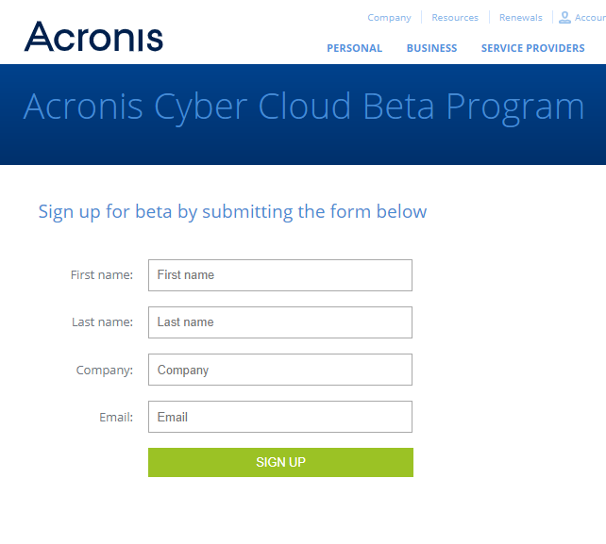
Your pre-launch checklist: beta instructions
With numerous enhancements to Acronis Cyber Cloud coming in version 8.0, it’s important that all employees who work with the solution (engineers, sales, marketing) in any way have a hands-on experience with the new features. Be sure they try them during the beta period.
Have custom integrations enabled?* Test the integration before your production account is updated to 8.0 – participation in the beta is critical.
Contact beta-cloud@acronis.com if you have any questions regarding new functionalities.
Log in to your beta account
Don’t have an existing beta account? Sign up here
* Via the platform API or backup API

Slide 19
New in Acronis Cyber Cloud Management Portal

Slide 20
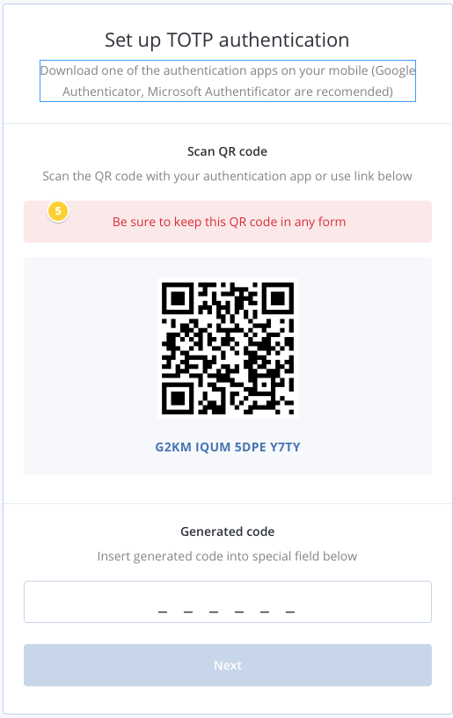
Two-step verification for login
Add an extra level of security for partner and customer tenants
Administrators can enable two-factor authentication (2FA) on a tenant level. This action forces all users to switch to 2FA and allows partners to track which users are enabling it.

Slide 21
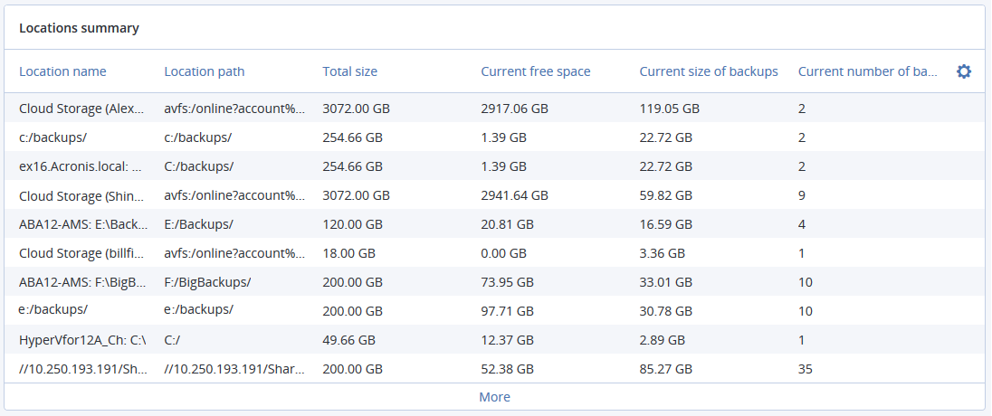
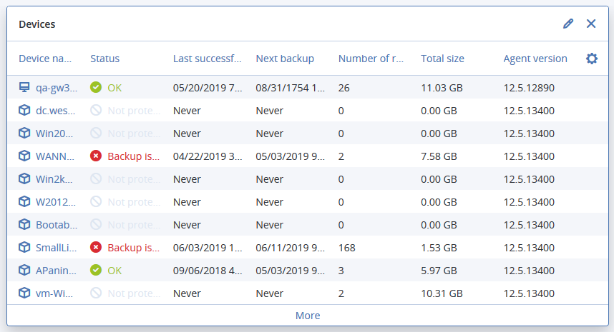
New widgets in dashboards and reports
Quickly review the protection statuses of all your devices as well as storage utilization in your locations
Simply add two new widgets to your dashboards and/or reports:
“Devices”
“Locations”

Slide 22
New Features in Acronis Backup Cloud

Slide 23
New features in Acronis Backup Cloud 8.0
Standard edition:
Ability to add comments to devices
New device status rules
New backup option: Backup file name
Startup Recovery Manager
Application-aware VM backup on Hyper-V
VM finalization on Hyper-V
Backup jobs time-window settings
Backup file notarization option
Granular Microsoft Exchange mailbox backup
Five locations for replication in a backup plan
Multiple UX improvements
Manual disk mapping when recovering machines
Backup retention-rules improvements
Default backup options management
Automatic system-information save, if a reboot recovery fails
Microsoft Office 365 public folders backup
New recovery option: Boot mode
Secure Zone management from the backup console
Assigning a virtual machine to a specific Agent for VMware (VM binding)
Advanced edition:
Group management of devices
Centralized backup plans management
Application-aware SAP HANA backup and recovery
Application-aware Oracle Database backup and recovery
Cluster-aware backup of Microsoft SQL Server
Cluster-aware backup of Microsoft Exchange Server
Script-based backup location targeting

Slide 24
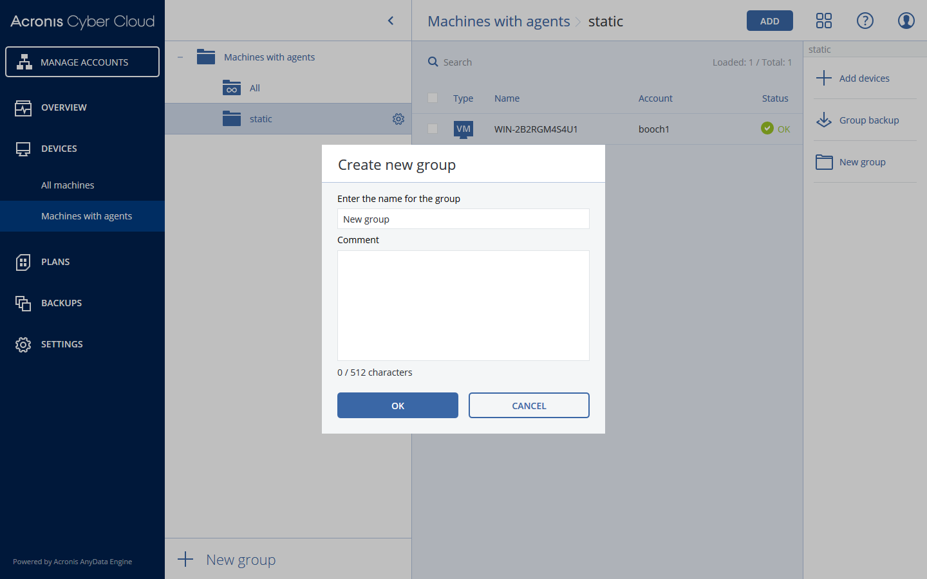
Group management of devices
Advanced edition
Manage a larger number of machines more quickly and easily
Create static or dynamic groups of machines and apply backup plans to the groups, not to each machine manually.
Once a new device is added to the group, the device becomes protected by the plan.
Notes:
Static groups
Static groups contain the machines that were manually added to them. The static group content never changes unless you explicitly add or delete a machine.
Dynamic groups
Dynamic groups contain the machines added automatically, per search criteria specified when creating a group. The dynamic group content changes automatically. A machine remains in the group while it meets the specified criteria

Slide 25
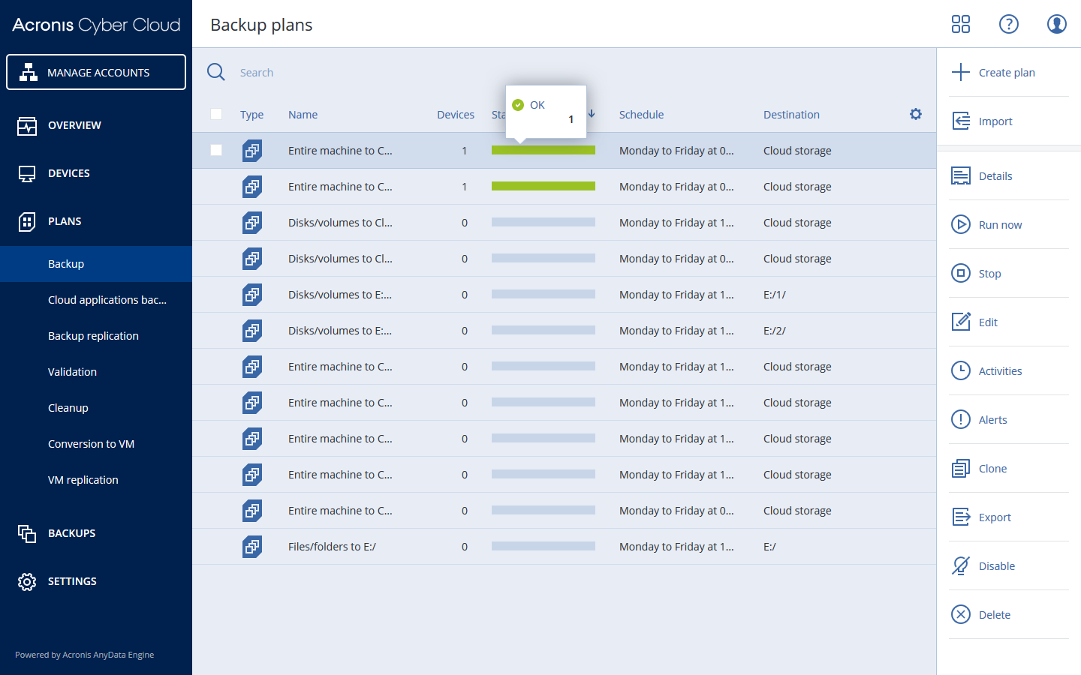
Centralized backup plans management
Advanced edition
Improve efficiency by managing backup plans from one tab
The new “Plans” tab shows all backup plans created in the account and their details.
You can create, edit, disable, enable, delete, start the execution and inspect the execution status of a plan.

Slide 26
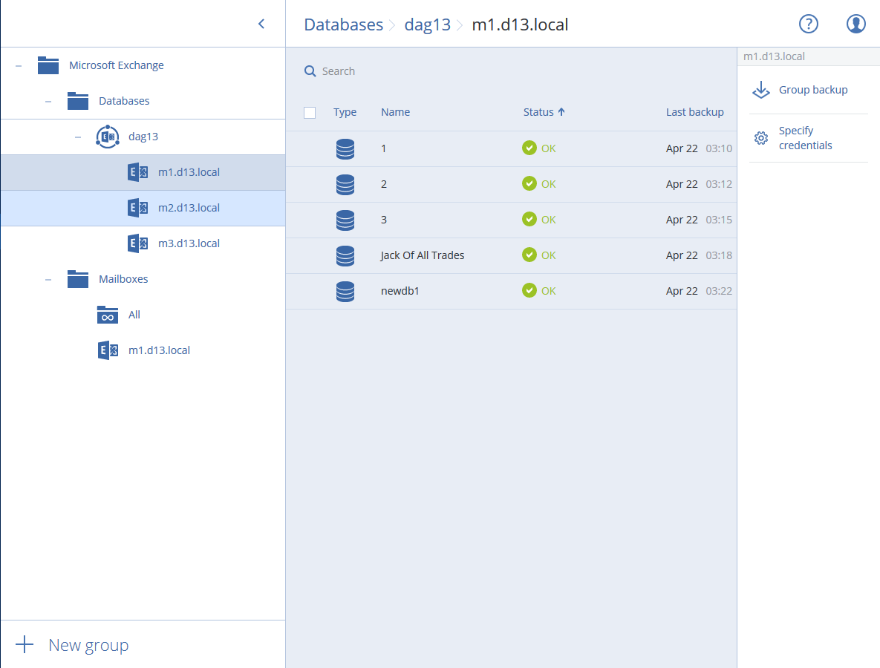
Cluster-aware backup of Microsoft SQL Server and Microsoft Exchange Server
Advanced edition
Enable backup and reliable recovery of clustered Microsoft applications data, even in case of a database logical corruption or a cluster-wide disaster.
Acronis Backup Cloud discovers and takes into account the structure of the cluster and tracks all data relocation to enable safe backups.

Slide 27
Application-aware SAP HANA backup
Advanced edition
Enable quick, reliable recovery of SAP HANA database servers
Physical server or VM
SAP HANA database
To protect the database data from disk storage failures and logical errors, you can create consistent disk-level backups of servers running SAP HANA in a simple, straightforward manner that does not require any SAP HANA knowledge or expertise.
You can then reliably recover SAP HANA servers to bare metal, same or different hardware, migrate them from a physical machine to a virtual machine and vice versa – the SAP HANA data inside the backup will be consistent.
Data volume
System volumes
Snapshot
Acronis Agent for Linux
Log volume
Snapshots via SAP HANA
Snapshots via Acronis SnapAPI
Image backups with consistent database volumes
Local and/or cloud storage

Slide 28
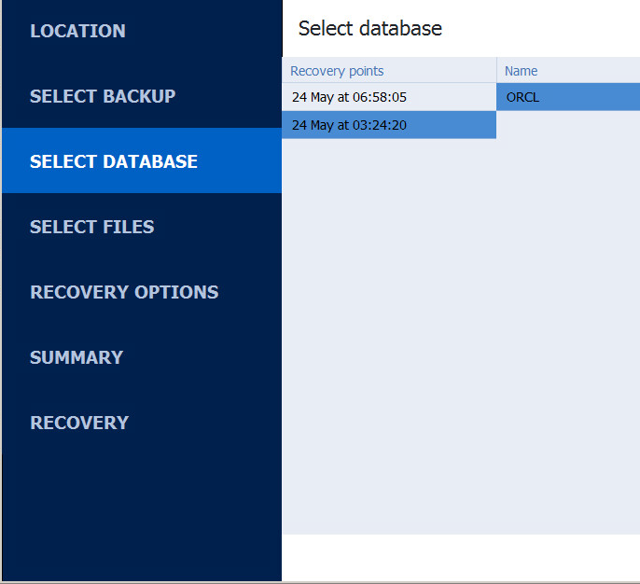
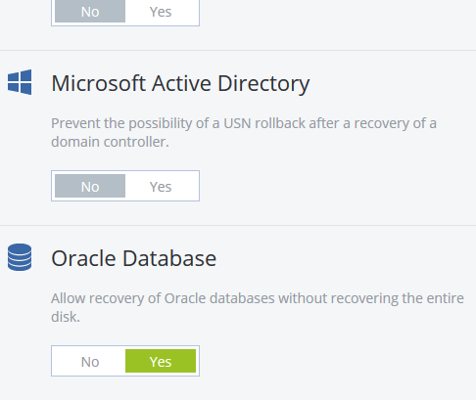
Application-aware Oracle Database backup
Advanced edition
Protect Oracle Database data and ensure quick application recovery times
Acronis Backup Cloud now includes application-aware server-level and database-level backup and recovery for Oracle Database.
It also offers integration with RMAN for restoration and ready-to-use RMAN scripts for more sophisticated scenarios.

Slide 29
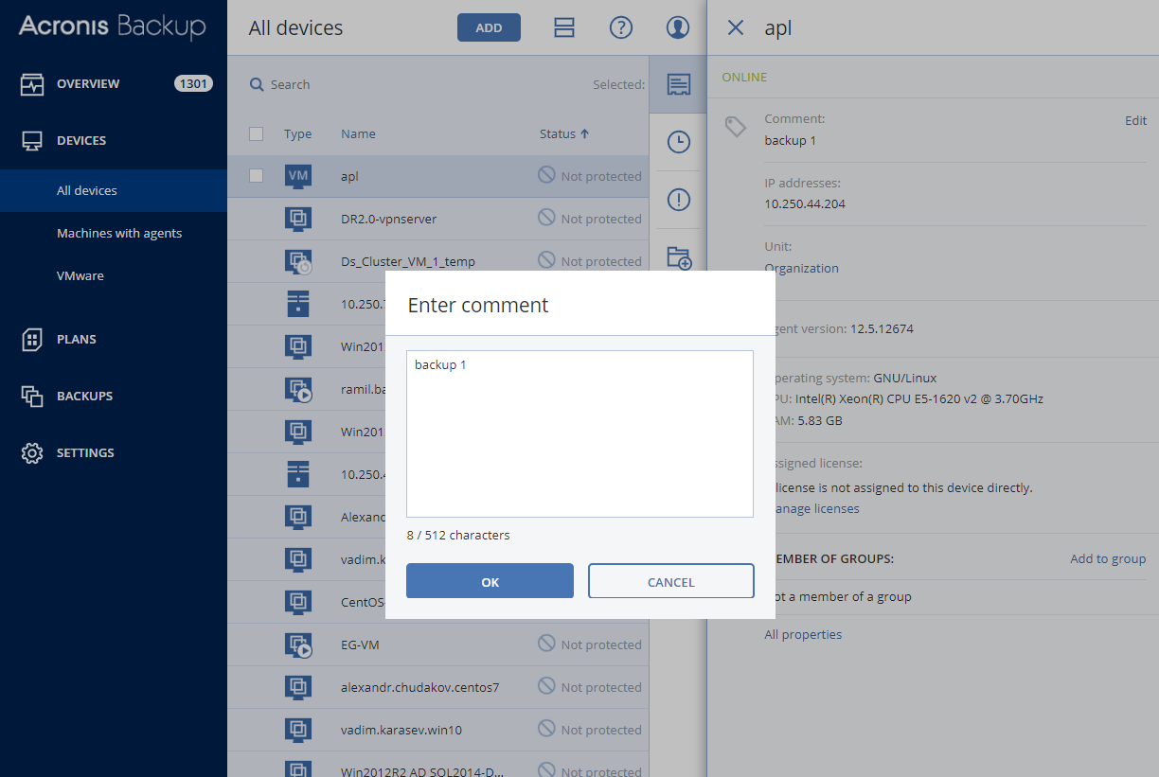
Ability to add comments to devices
Standard edition
Organize devices and add comments for your colleagues and customers
By adding comments to the machines you can:
Organize devices
Add useful notes for your team members
Search devices
Group them by keywords (Advanced edition)

Slide 30
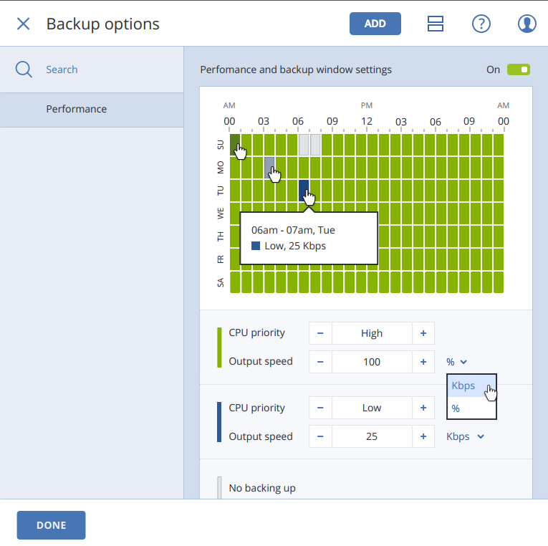
Backup jobs time-window settings
Standard edition
Minimize impact on running systems by setting backup window times in your backup plans
You can set up a preferable backup timeframe, define the priority of the backup process in the operating system, and limit the output speed during backups.

Slide 31
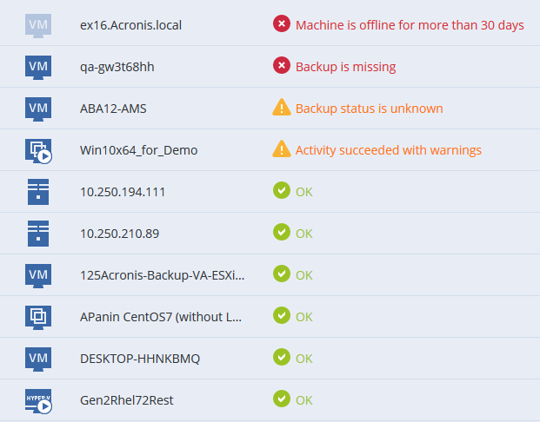
New device status rules
Standard edition
Troubleshoot faster with new alert-based statuses
Alerts cover a wider range of events than just backup activity results, e.g. missed backups and ransomware activities.
The statuses are now much more descriptive so you can quickly understand what the problem is (instead of just “error” or “warning” notices).
You can clear alerts manually – that will change the status to “OK”.

Slide 32
New backup option: Backup file name
Standard edition
Continue an existing sequence of backups no matter what
There are two main reasons to use the new backup file-name templates:
To force the backup plan to continue backing up to the same backup or backup sequence – as opposed to starting a full backup from scratch.
To benefit from more user-friendly backup file names, which you define manually.

Slide 33
Startup Recovery Manager
Standard edition
Restore machines quickly even if the operating system does not load – without a separate rescue media or network connection
Startup Recovery Manager is a bootable component that lives on the system disk in Windows, or on the /boot partition in Linux (where it is configured to start by pressing F11 at boot time).
On Windows and Linux machines, activate the Startup Recovery Manager using the backup console.

Slide 34
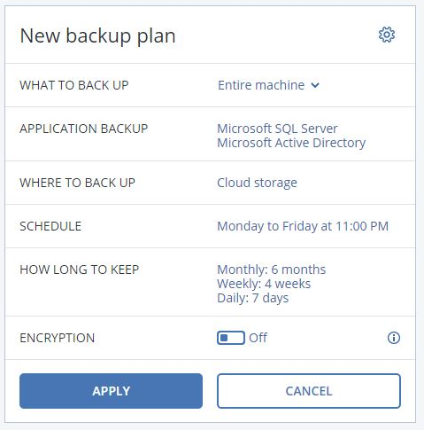
Application-aware VM backup on Hyper-V
Standard edition
Enable application-aware backup of Hyper-V VMs without the need to install per-VM agents
Gain ease-of-use and cost-efficiency.
The new application-aware backup of Hyper-V VMs by the Agent for Hyper-V improves backup and recovery of Microsoft SQL Server, Microsoft Exchange Server, Microsoft SharePoint, and Active Directory Domain Services running on Hyper-V.

Slide 35
VM finalization on Hyper-V
Standard edition
Finalize Hyper-V virtual machines running from backups during recovery via Acronis Instant Restore
Finalization is the process of converting a temporary virtual machine (that runs directly from backup during local failover) to a regular virtual machine (when all of its virtual disks and the changes that occurred while the machine was running are recovered to the production datastore) – without downtime.

Slide 36
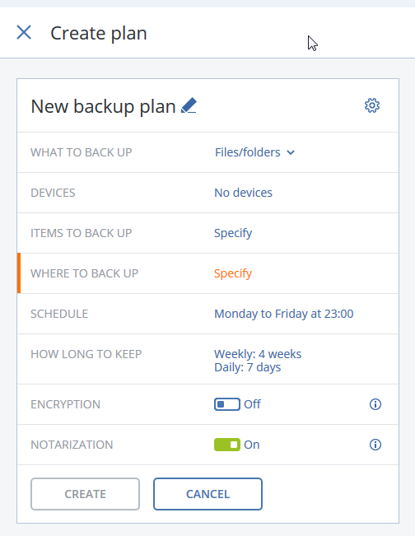
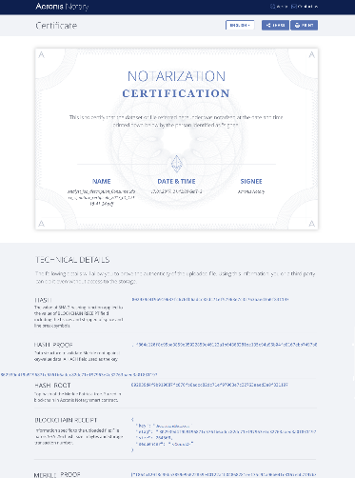
Backup file notarization option
Standard edition
Get independent validation that particular files are unchanged
To automatically notarize all files selected for backup, simply enable the Notarization option when creating a backup plan.
When configuring recovery, the notarized files will be marked with a special icon so you can easily verify the file’s authenticity.

Slide 37
Other new features (1)
Assigning a virtual machine to a specific Agent for VMware (VM binding)
Assign a specific Agent for VMware to manage a specific virtual machine – as opposed to the default automatic agent-machine assignment. Manual binding is required in different cases, such as: if the Agent for VMware (virtual appliance) has a locally attached storage, you will want to assign a dedicated agent to a very large VM; or, if you have multiple ESXi hosts that are separated geographically; etc.
Granular Microsoft Exchange mailbox backup
Back up and recover specified mailboxes without the need to back up the entire server or databases. This backup is done remotely so there is no need to install the Exchange agent on the machine with the Exchange server.
Five locations for replication in a backup plan
Increase data safety and accessibility and balance data retention and storage costs more precisely. You can specify up to five locations where backups are replicated, plus set up separate rules for each location, e.g. retention rules and backup jobs window settings.
Multiple UX improvements
Expedite operations with a redesigned “backups” tab – you can configure several backup plans to the same location and create folders on the machines without leaving the backup console.
Backup retention-rules improvements
Specify how long to keep backups (e.g. based on the total size of backups in local storage) and when to start a cleanup procedure – before or after backups.
Manual disk mapping when recovering machines
Re-map disks or volumes manually if you are dissatisfied with the disk-mapping result when performing recovery, or if the disk-mapping fails.

Slide 38
Other new features (2)
New recovery option: Boot mode
Select the boot mode that Windows will use after a recovery (BIOS or UEFI). If the original machine’s boot mode is different from the selected boot mode, the software will initialize the recovery-to disk according to the selected option. Then it will adjust the Windows operating system so that it can start using the selected mode.
Microsoft Office 365 public folders backup
Configure backup and recovery of Office 365 public folders data – in addition to many other types of items in Office 365.
Secure Zone management from the backup console
Create and delete Secure Zones on the protected machines without leaving the backup console. You can specify the Secure Zone size and enable password protection if needed. Secure Zone is a secure partition on a disk of the backed-up machine, which is used to store these machine backups. It is a cost-effective and handy method for protecting backups from software malfunctions, virus attacks, or human error. It enables quick recovery from the same disk where the backup resides – with no need for a separate media or network connection to recover the data.
Automatic system-information save, if a reboot recovery fails
Troubleshoot recovery tasks quickly by saving the log, system information and crash-dump files to a specified folder. These files help technical support personnel identify the problem faster.
Default backup options management
Change a default option value against the pre-defined one for some backup options. The new value will be used by default in all backup plans created after you initiate the change.

Slide 39
New Features in Acronis Disaster Recovery Cloud

Slide 40
Acronis Disaster Recovery Cloud is not yet available in the EU1 data center (Strasbourg, France).
We aim to enable the service in this data center in Q3 2019.

Slide 41
Encrypted backups support
Comply with data security requirements
Perform failover using encrypted backups and allow the system to use the securely stored passwords for automated disaster recovery operations.
The new Credential Store feature (accessible from the web console in the Disaster Recovery > Credential Store tab) allows you to securely store and manage passwords for encrypted server backups.
Comply with various data regulations (like HIPPA).

Slide 42
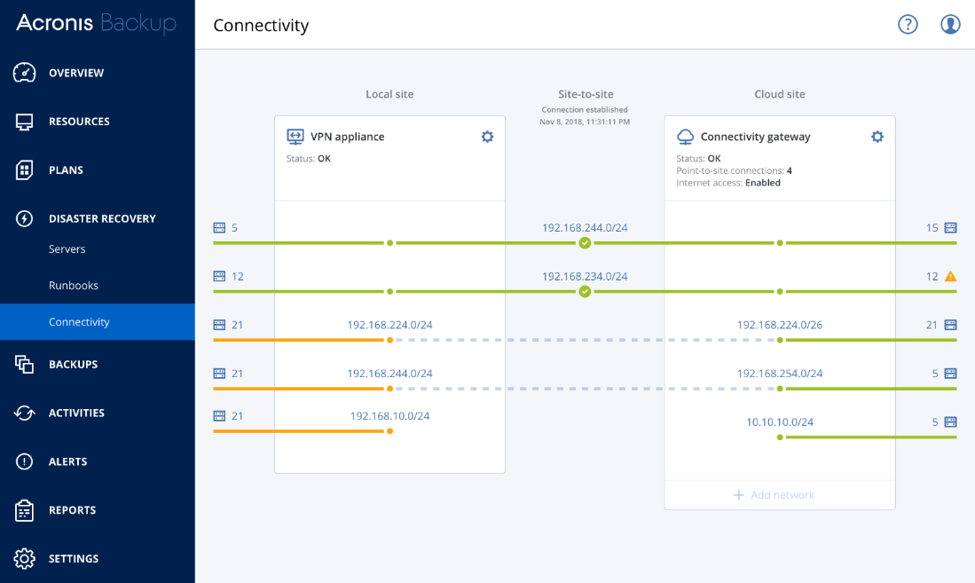
Multiple networks support
Support more complex customer infrastructures
Extend up to five local networks to the Acronis Cloud Recovery Site through the single site-to-site connection.
Failover complex environments where protected servers are distributed across several network segments.
See connectivity statuses of all five networks in one view.

Slide 43
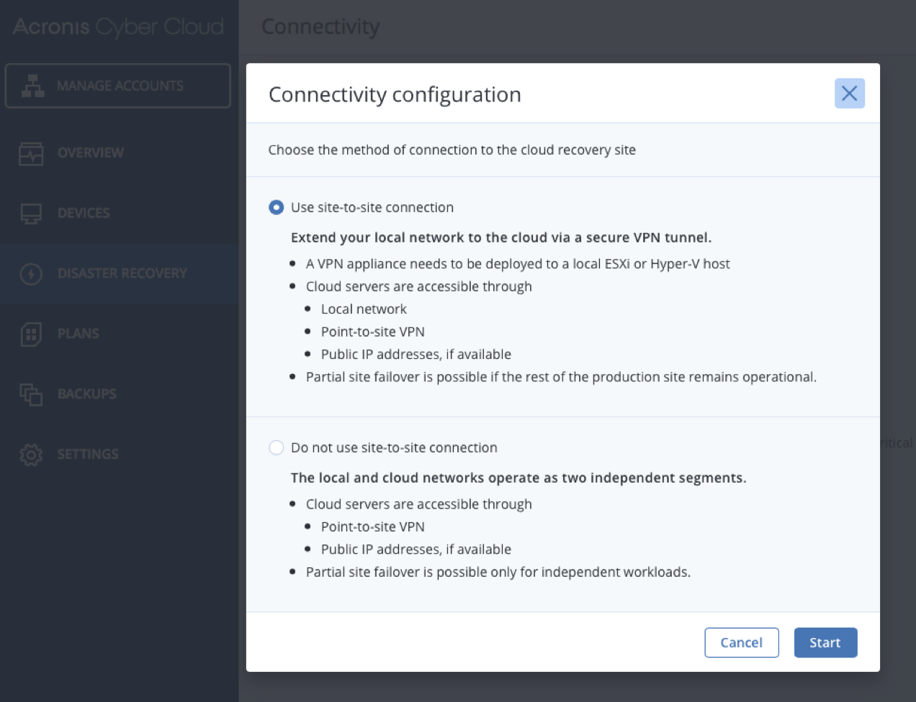
VPN-less deployment option
Onboard customers more quickly and easily
VPN virtual appliance is not necessary for “point-to-site” connectivity.
Switch from the “point-to-site” to “site-to-site” mode as you wish.
This option is especially useful for customers who want to quickly evaluate the service or don’t need to extend the local network to the cloud site.

Slide 44
Recovery servers RPO compliance tracking
Improve SLA compliance
Define recovery point thresholds for the recovery servers to identify how "fresh" the cloud backup of the original machine (to perform failover) should be.
Track recovery point objective (RPO) compliance in real time via the web console. Get alerts if the threshold is exceed.

Slide 45
New “Disaster Recovery” section
Reduce management overhead
Find all disaster recovery controls conveniently located in the new “Disaster Recovery” section.
Manage key functionality using separated tabs: server list, runbooks, connectivity settings.

Slide 46
Redesigned cloud server management UI
Gain greater visibility into your cloud server environment
Improvements in the cloud server management interface include:
Device statuses are now more informative and actionable, and based on alerts.
The “Machine status” column is kept in the table but is now called “State”.
A new “VM state” column is added.
The “Backup status” column is replaced with a more informative “Last recovery point” column.

Slide 47
New Features in Acronis Notary Cloud

Slide 48
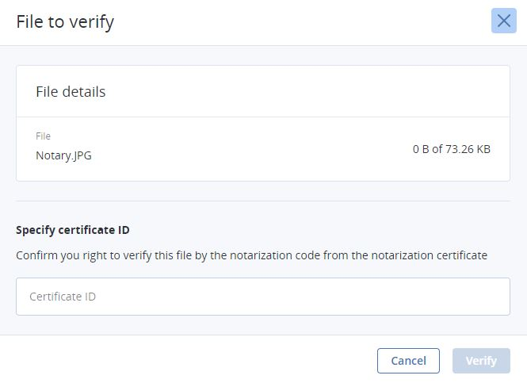
New in Acronis Notary Cloud (1)
Employ public verification while staying compliant with strengthened security
Enable verification via a new public webpage that allows users to verify files without utilizing the Acronis Notary Cloud UI.
Verify data with ease by uploading a file or even just its hash – this is especially useful for companies with strict compliance standards.
Stay secure with limited access to file verification. A notarization certificate ID is now required for every verification transaction.

Slide 49
New in Acronis Notary Cloud (2)
Utilize personalized notarization certificates for better transparency
Benefit from redesigned Notarization Certificates. Certificates include more helpful information like transaction requestor (company and person), file size, hash and more.

